Slide 1
TRANSPORTATION APPLICATIONS OF NOVEL INTELLIGENT IoT PREDICTIVE MAINTENANCE SENSORS AND SENSOR
(IoT INTELLIGENT FATIGUE DAMAGE SENSOR APPLICATIONS)
FATIGUE OF HIGHWAY SIGNS, LUMINAIRES, AND TRAFFIC SIGNALS

Slide 2
FATIGUE OF HIGHWAY SIGNS, LUMINAIRES, AND TRAFFIC SIGNALS

Slide 3
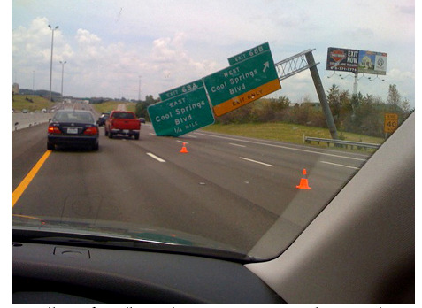
Transportation Overhead Sign Database Program for structural health monitoring and smart predictive maintenance

Slide 4
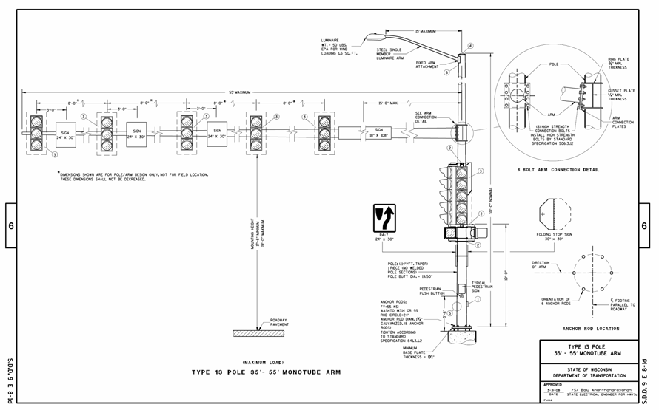
Transportation Overhead Sign Database Program for structural health monitoring and smart predictive maintenance

Slide 5
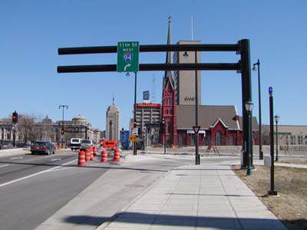
Transportation Overhead Sign Database Program for structural health monitoring and smart predictive maintenance

Slide 6
Transportation Overhead Sign Database Program for structural health monitoring and smart predictive maintenance

Slide 7
Transportation Overhead Sign Database Program for structural health monitoring and smart predictive maintenance

Slide 8
Transportation Overhead Sign Database Program for structural health monitoring and smart predictive maintenance
Example Inventory Checklist The checklist below is referenced from the New Jersey Department of Transportation Overhead Sign Database Program. These are items deemed important to that particular agency, and will of course vary somewhat with individual State needs. Many items involve the physical location of the structure, the personnel involved with the inventory/inspection, specifics about the structure itself, important dimensions and attachments.  NJDOT Required Inventory / Inspection Information • Date Inspected • Previous Inspection Date • Inspection Type • Cycle Number • Recommended Inspection Frequency • County Code • Municipality Code • Latitude/Longitude • Route • Milepost • Location Description • Traffic Control Requirements • Contract Number • Consultant Firm Name • Consultant Project Manager • Consultant Team Leader • Confirming Registered PE • Structure Name • Structure Configuration • Number of Truss Sections • Material Type • In Service Status and Date • Overall Span Length • Minimum Vertical Clearance • Left and Right Lateral Clearance • Number of Traveled Lanes • Number of Signs • Area of each Sign • Installation Year • Plans Available? • Walkway? • Lighting? • Modification since construction • Damage Reports • Element Ratings 39 • Element Repairs

Slide 9
Transportation Overhead Sign Database Program for structural health monitoring and smart predictive maintenance

Slide 10
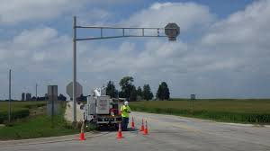
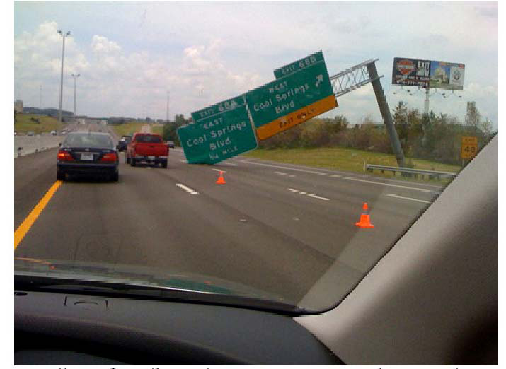
Transportation Overhead Sign Database Program for structural health monitoring and smart predictive maintenance

Slide 11
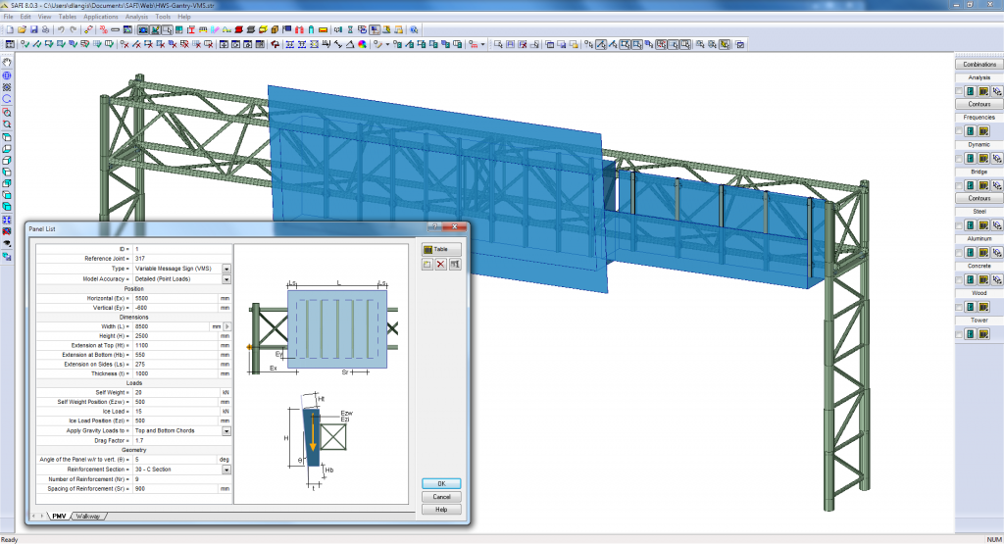
Transportation Overhead Sign Database Program for structural health monitoring and smart predictive maintenance

Slide 12
Transportation Overhead Sign Database Program for structural health monitoring and smart predictive maintenance

Slide 13
Transportation Overhead Sign Database Program for structural health monitoring and smart predictive maintenance

Slide 14
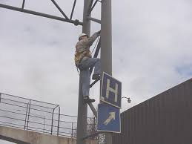
Transportation Overhead Sign Database Program for structural health monitoring and smart predictive maintenance
When a pretensioned joint is subject to cyclic fatigue loads, it acts as if the pieces pressed together were actually monolithic (i.e., the bolts themselves feel only about 20 percent of the load range), with the majority of the load range transferred through the faying surfaces. When a bolted joint is not properly pretensioned, all the load range is transferred through the bolts and they may quickly fail by fatigue.

Slide 15
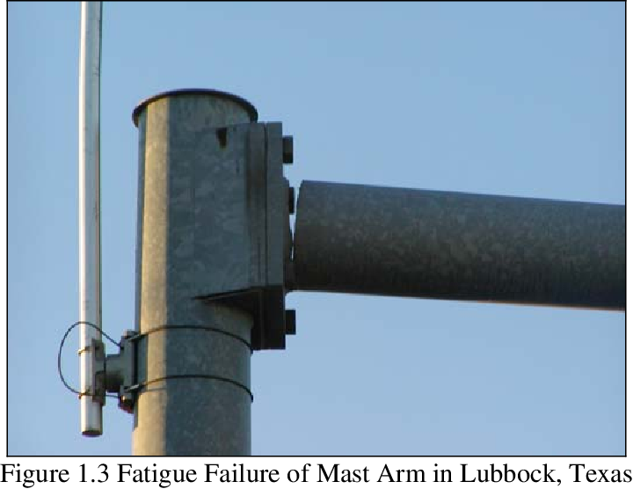
Transportation Overhead Sign Database Program for structural health monitoring and smart predictive maintenance

Slide 16
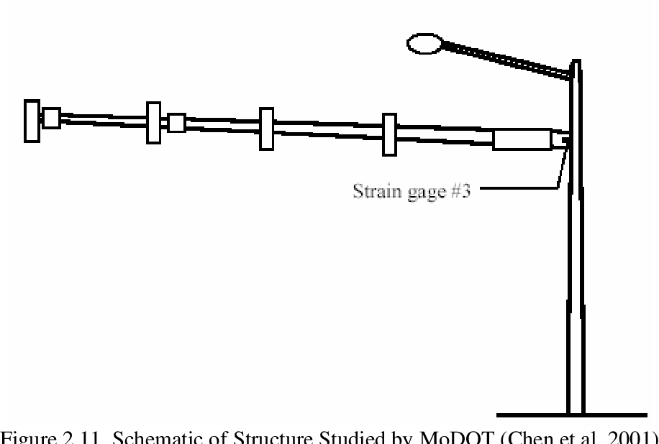
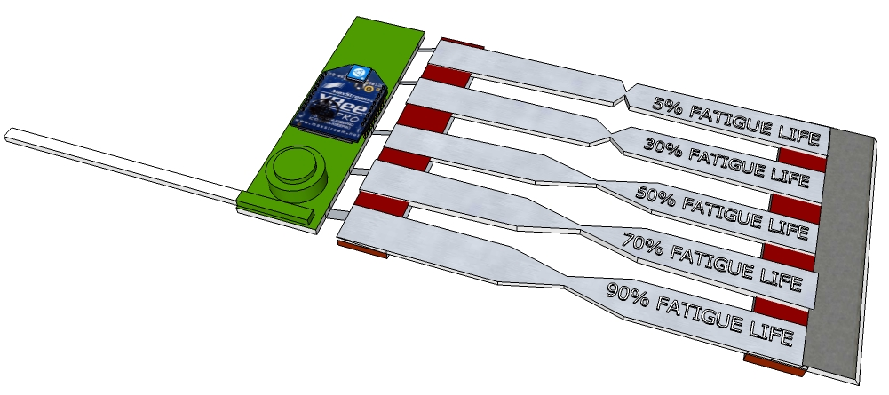
Transportation Overhead Sign Database Program for structural health monitoring and smart predictive maintenance

Slide 17
Transportation Overhead Sign Database Program for structural health monitoring and smart predictive maintenance
Dynamic Message Signs (DMSs) are increasingly used in highways as an effective means to communicate time-sensitive information with motorists. To ensure the long-term performance of DMSs, it is critical to ensure that the truss structures that hold them can resist not only extreme loading events, but also fatigue induced by service loads. The existing studies, however, are primarily focused on the loads that DMS-support structures experience during their service life and neglect the potential contribution of stresses induced during the transportation of them from the fabrication site to the location of installation. As a result, the potential damage that this important category of structures may sustain during transportation had remained largely unknown. To investigate this aspect, a comprehensive field test and numerical study were conducted. For field investigation, one span of a four-chord, overhead sign-support structure was instrumented to perform a short-term structural health monitoring. In addition, detailed finite element simulations were conducted to obtain an in-depth understanding of the potential modes of damage under the excitations induced by the road profile. The outcome of this study is expected to contribute to evaluating the extent of fatigue and structural vulnerability of DMS-support structures during transportation.

Slide 18
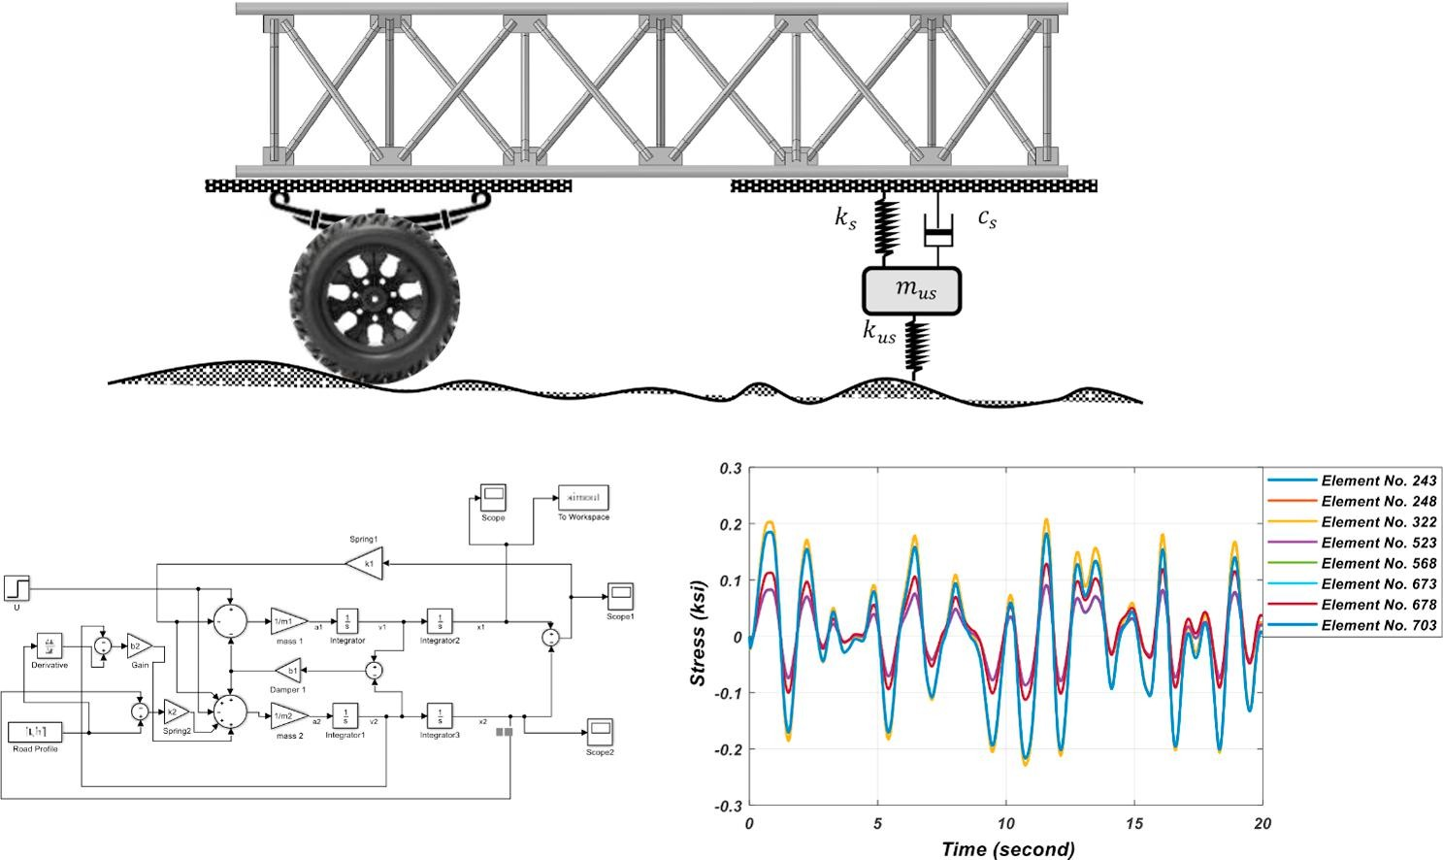
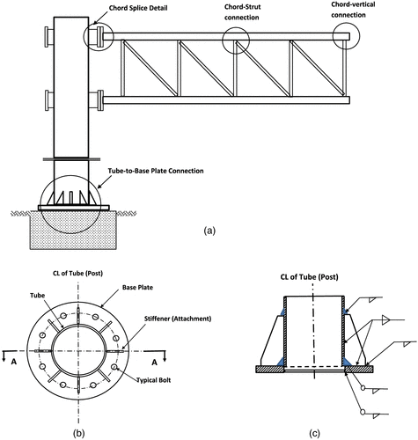
Transportation Overhead Sign Database Program for structural health monitoring and smart predictive maintenance

Slide 19
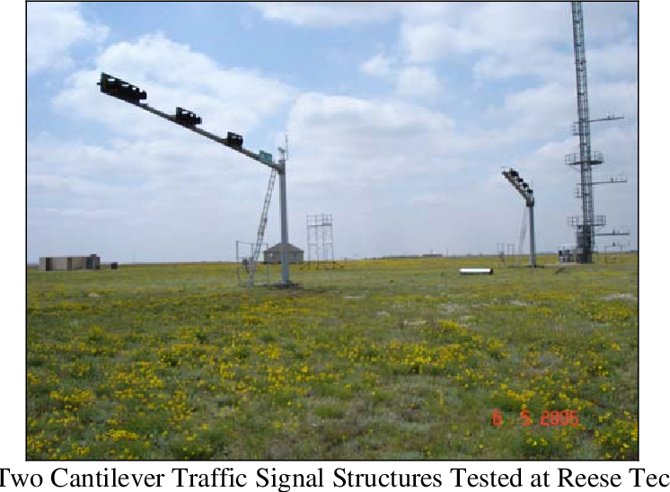
Transportation Overhead Sign Database Program for structural health monitoring and smart predictive maintenance

Slide 20
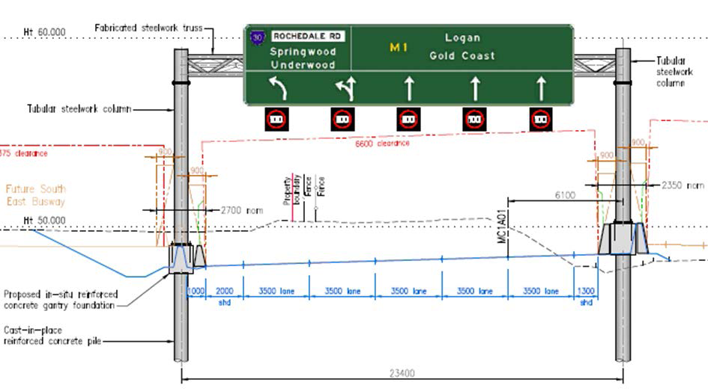
Transportation Overhead Sign Database Program for structural health monitoring and smart predictive maintenance

Slide 21
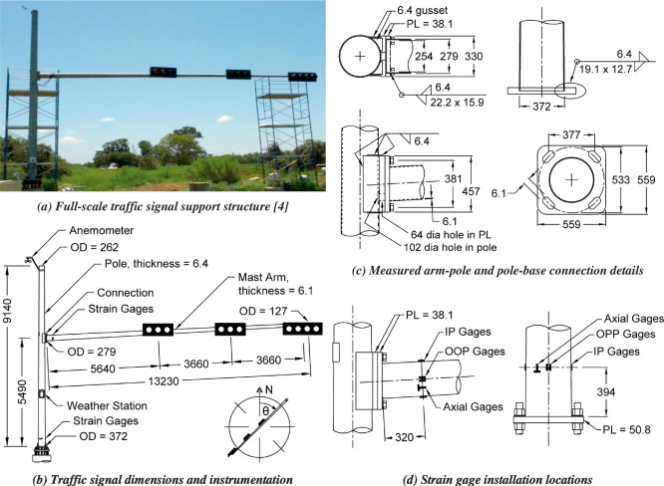
Transportation Overhead Sign Database Program for structural health monitoring and smart predictive maintenance

Slide 23
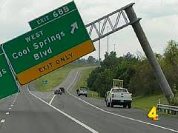
Transportation Overhead Sign Database Program for structural health monitoring and smart predictive maintenance

Slide 24
Transportation Overhead Sign Database Program for structural health monitoring and smart predictive maintenance

Slide 25
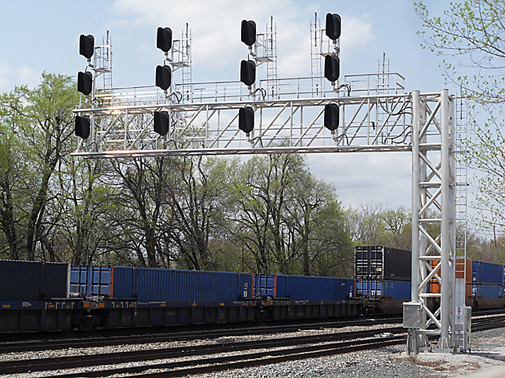
Transportation Overhead Sign Database Program for structural health monitoring and smart predictive maintenance

Slide 26
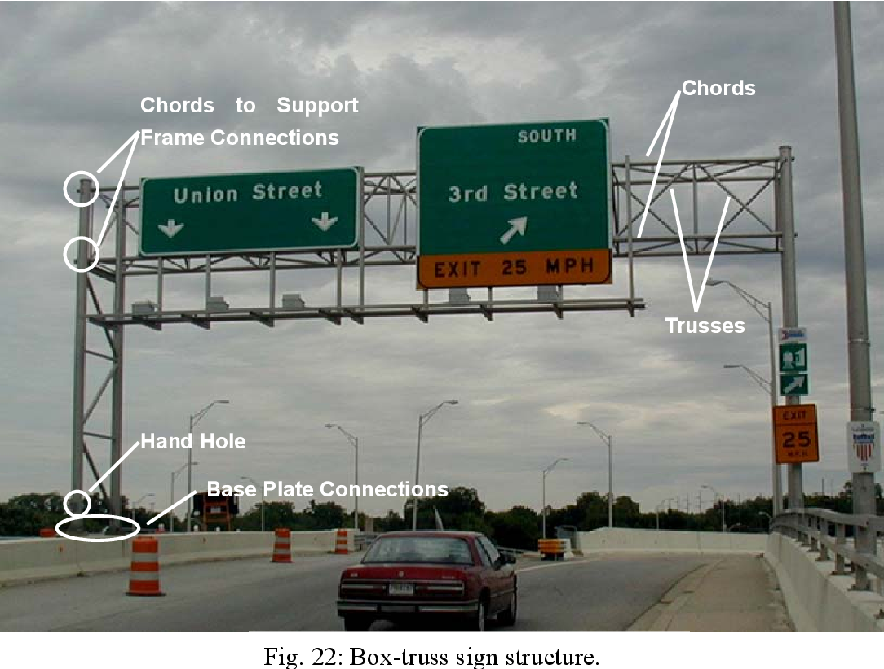
Transportation Overhead Sign Database Program for structural health monitoring and smart predictive maintenance

Slide 27
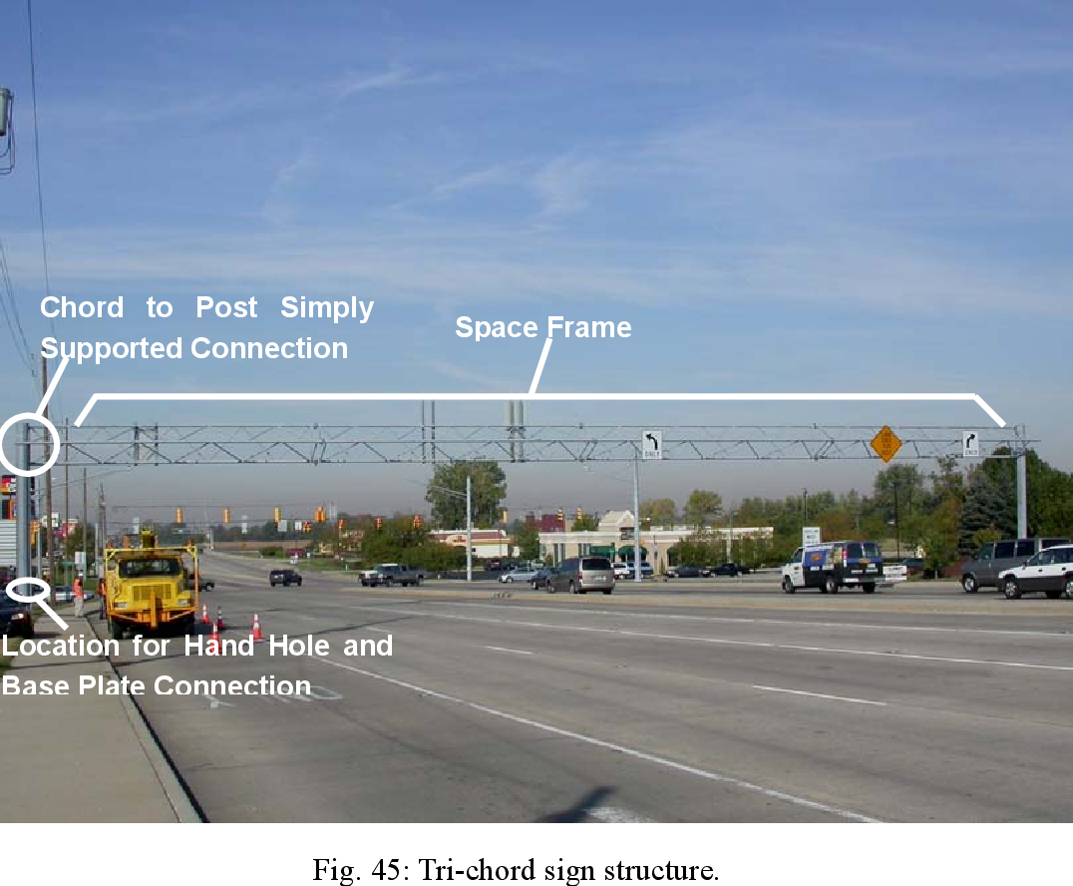
Transportation Overhead Sign Database Program for structural health monitoring and smart predictive maintenance

Slide 28
Transportation Overhead Sign Database Program for structural health monitoring and smart predictive maintenance

Slide 29
Transportation Overhead Sign Database Program for structural health monitoring and smart predictive maintenance

Slide 30
Transportation Overhead Sign Database Program for structural health monitoring and smart predictive maintenance

Slide 31
Transportation Overhead Sign Database Program for structural health monitoring and smart predictive maintenance

Slide 32
Transportation Overhead Sign Database Program for structural health monitoring and smart predictive maintenance
Example Inventory Checklist The checklist below is referenced from the New Jersey Department of Transportation Overhead Sign Database Program. These are items deemed important to that particular agency, and will of course vary somewhat with individual State needs. Many items involve the physical location of the structure, the personnel involved with the inventory/inspection, specifics about the structure itself, important dimensions and attachments.  NJDOT Required Inventory / Inspection Information • Date Inspected • Previous Inspection Date • Inspection Type • Cycle Number • Recommended Inspection Frequency • County Code • Municipality Code • Latitude/Longitude • Route • Milepost • Location Description • Traffic Control Requirements • Contract Number • Consultant Firm Name • Consultant Project Manager • Consultant Team Leader • Confirming Registered PE • Structure Name • Structure Configuration • Number of Truss Sections • Material Type • In Service Status and Date • Overall Span Length • Minimum Vertical Clearance • Left and Right Lateral Clearance • Number of Traveled Lanes • Number of Signs • Area of each Sign • Installation Year • Plans Available? • Walkway? • Lighting? • Modification since construction • Damage Reports • Element Ratings 39 • Element Repairs

Slide 33
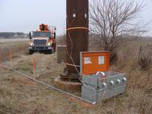
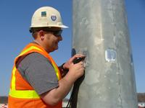
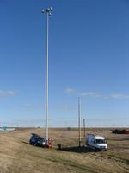
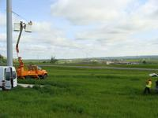
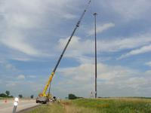
Transportation Overhead Sign Database Program for structural health monitoring and smart predictive maintenance

Slide 34
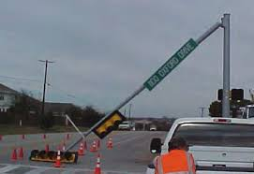
Transportation Overhead Sign Database Program for structural health monitoring and smart predictive maintenance

Slide 35
Transportation Overhead Sign Database Program for structural health monitoring and smart predictive maintenance

Slide 36
Transportation Overhead Sign Database Program for structural health monitoring and smart predictive maintenance

Slide 37
Transportation Overhead Sign Database Program for structural health monitoring and smart predictive maintenance

Slide 38
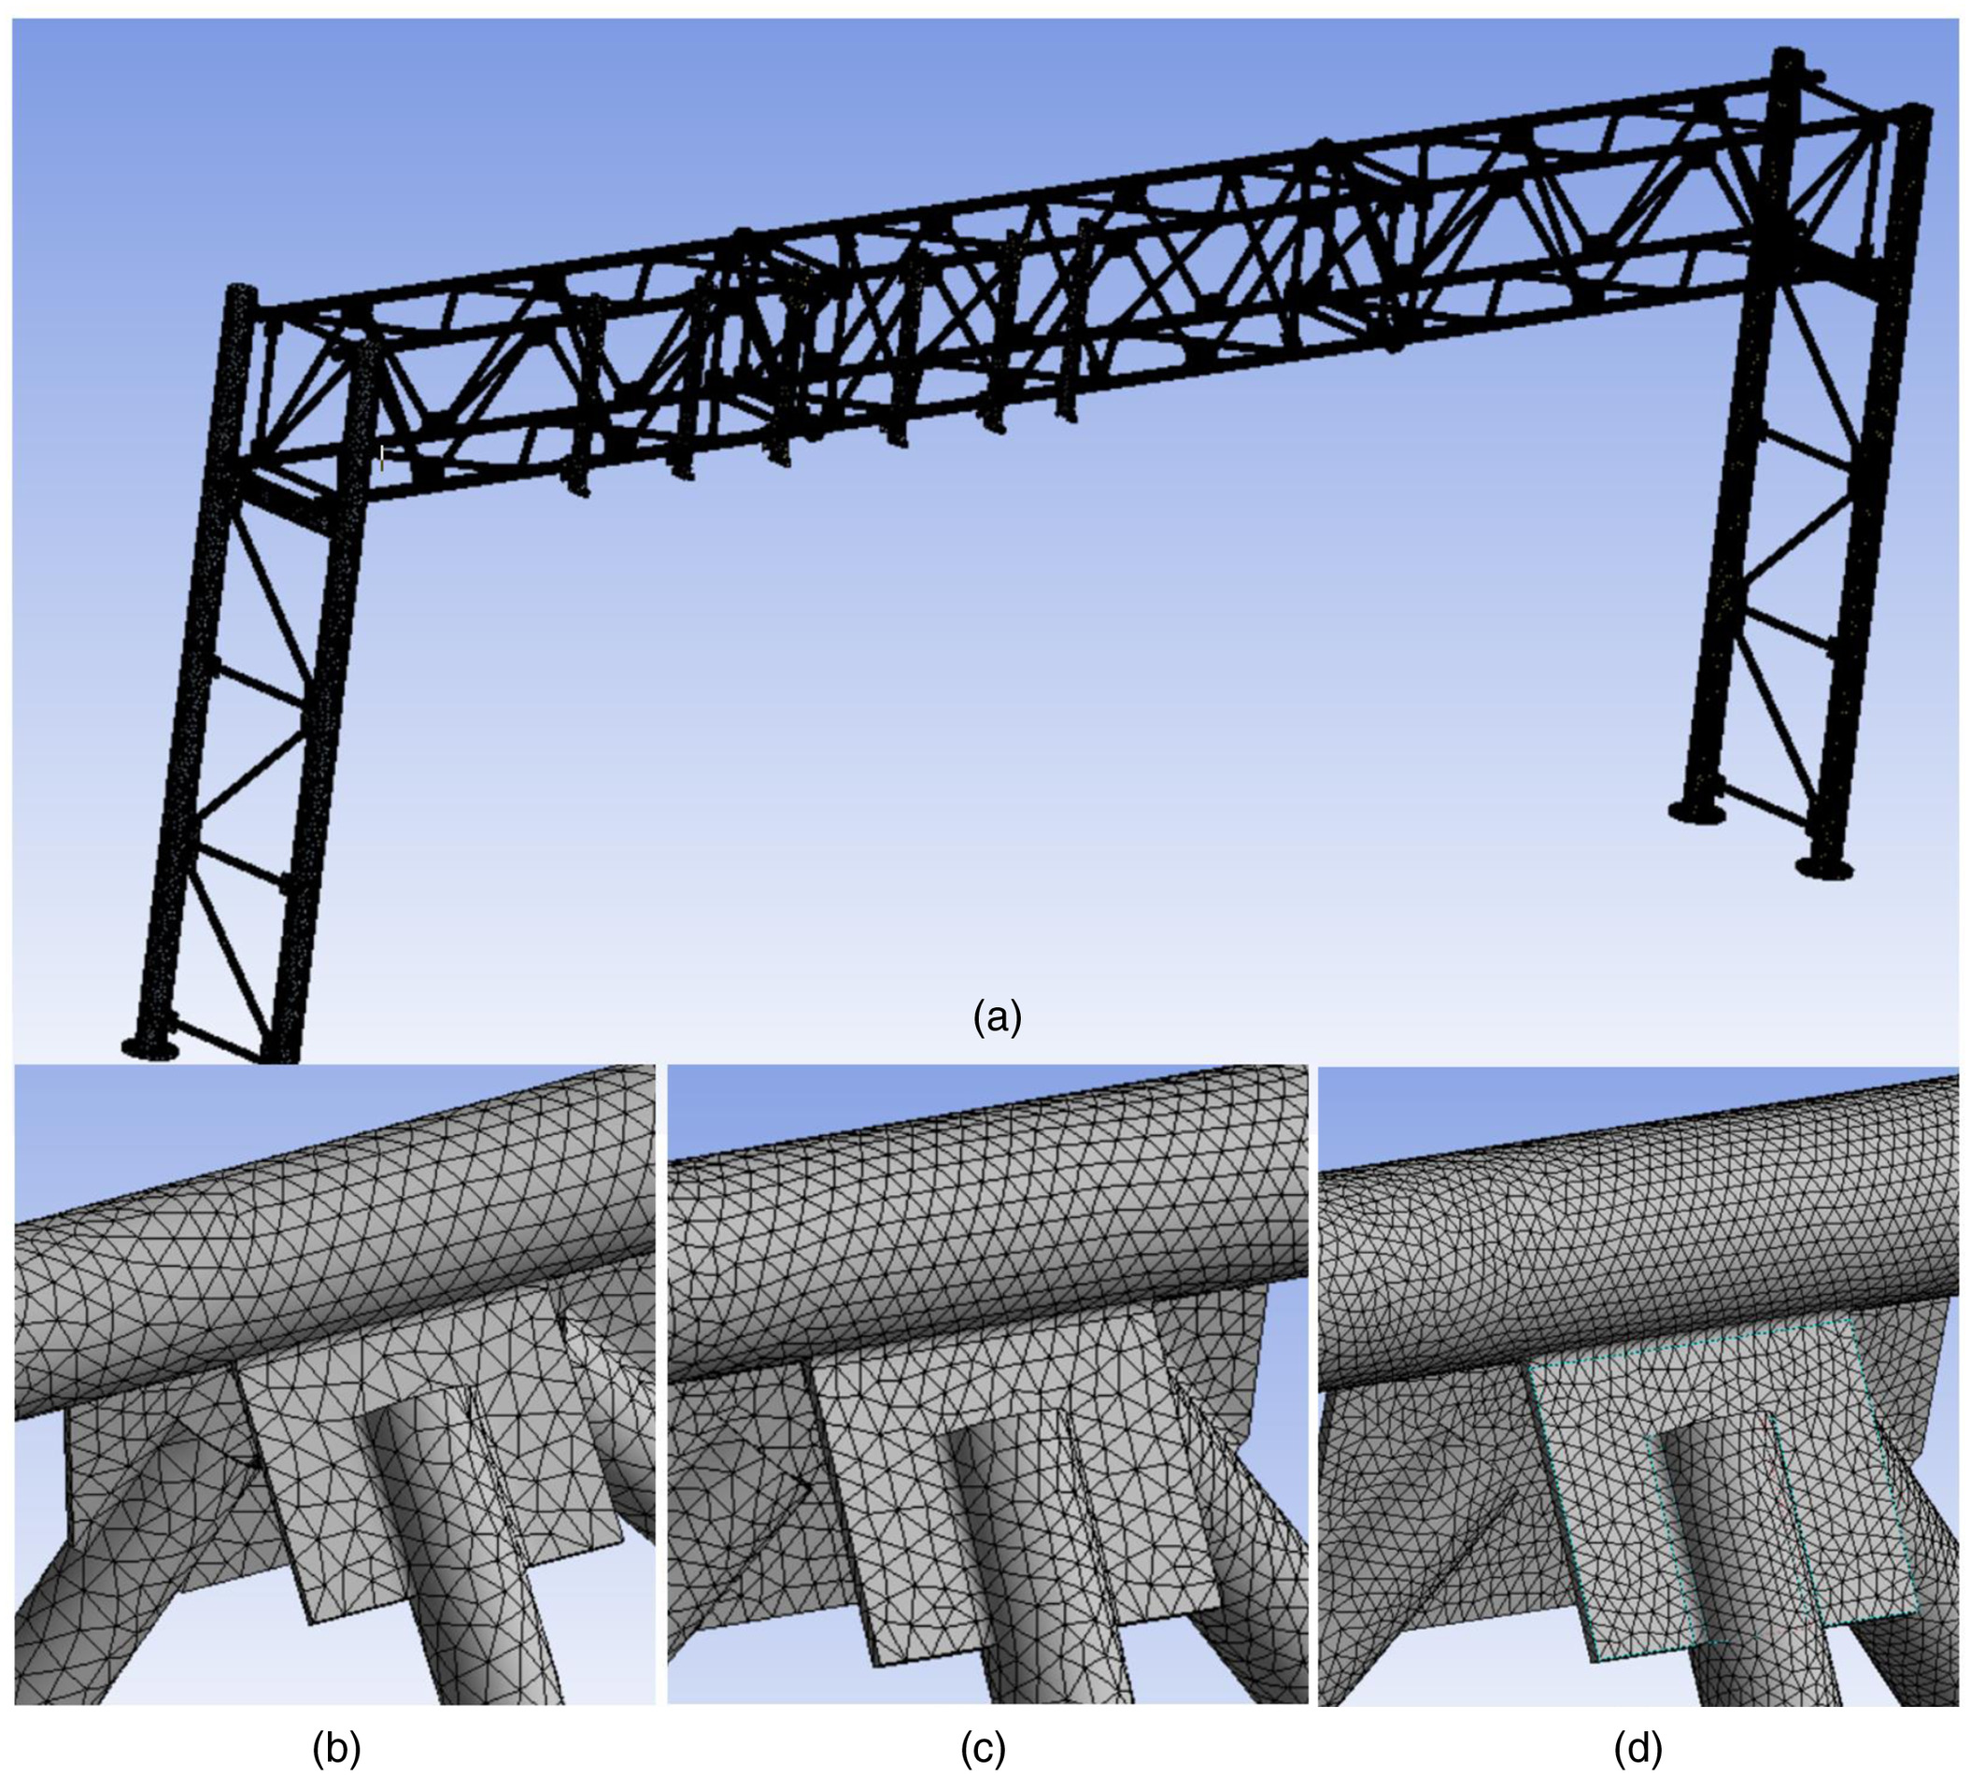
Transportation Overhead Sign Database Program for structural health monitoring and smart predictive maintenance

