Slide 1


FatigPro
Structural Health Monitoring Sensor
Early Warning saves lives

Slide 2

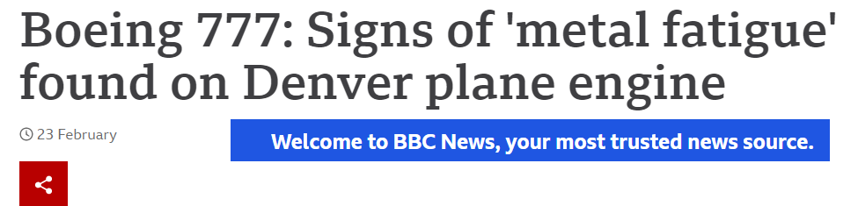
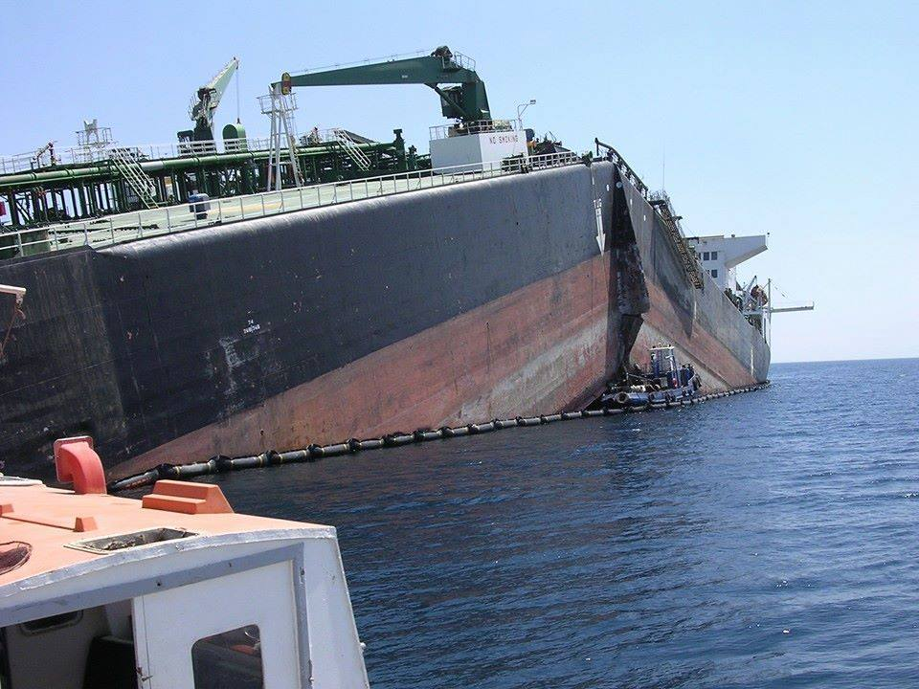
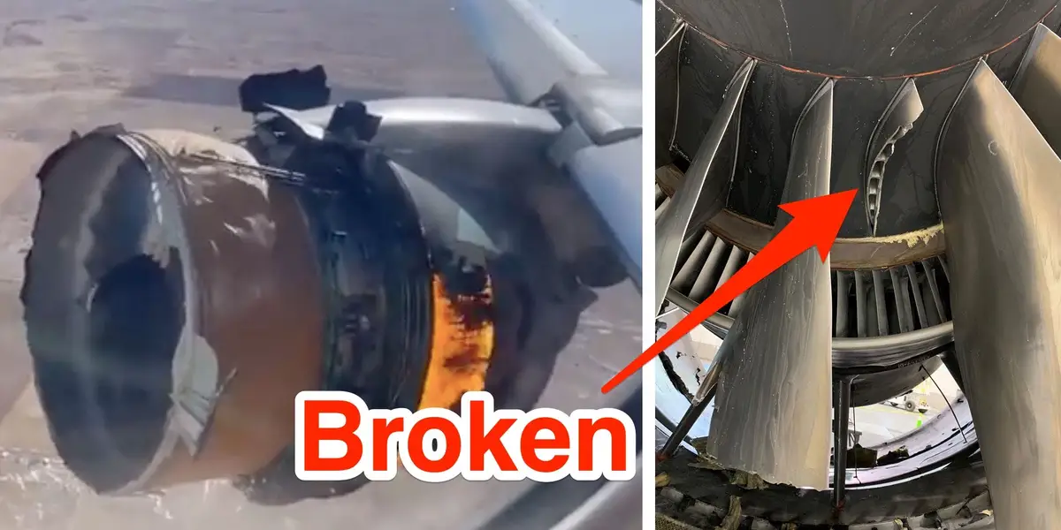
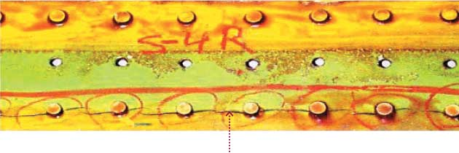
Metal Fatigue – a huge problem
90% of all industrial accidents are caused by metal fatigue

Slide 3
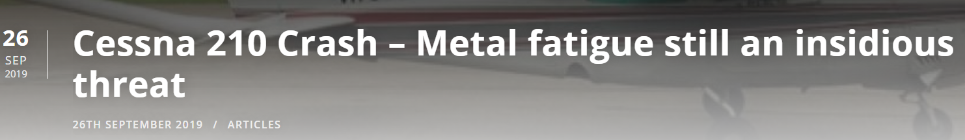
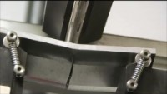
Why metal fatigue is a problem?
Insidious…. You don’t see any change until it is too late
https://youtu.be/hASl6d3z3BM

Slide 4
What is happening?..shown in true scale
108,000 cycle
216,000 cycle
324,000 cycle
432,000 cycle
486,000 cycle
120 min
240 min
270 min
60 min
180 min
Crack appears but almost invisible
Test is running at 30 Hz for 4.5 hours at 20 KSI
KSI: kilopound per square inch
1 KSI= 6.89 MPa
255 min
Total failure
Crack becomes visible

Slide 5
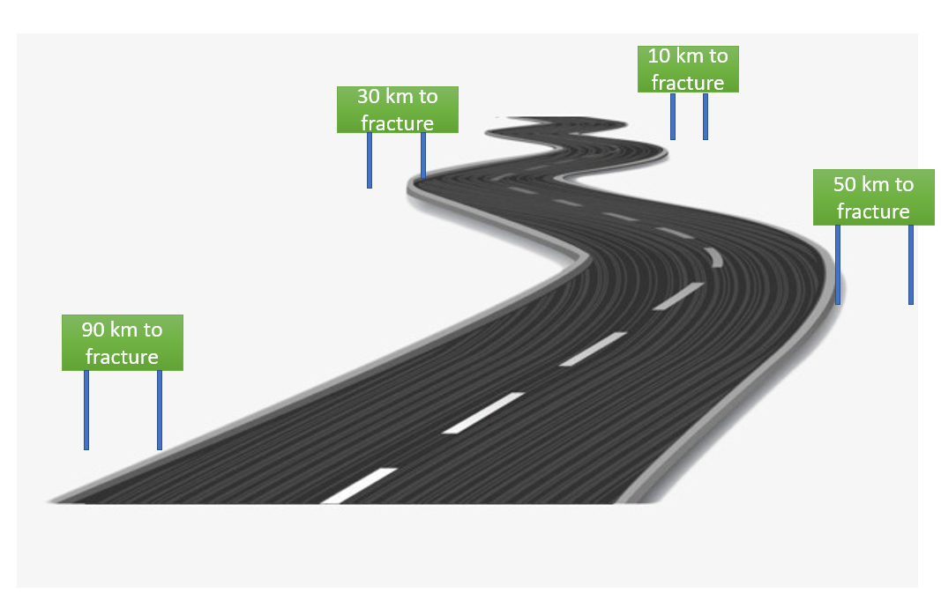
What is our solution? FatigPro
A sensor to track fatigue life of the structural parts,
Sensor is attached to critical locations just like strain gauge,
Gives feedback as part reaches 10%, 50%, 70%, 80%, 90% of fatigue life,
Works like mileage signs,
No estimation, based on true load,
Works without battery

Slide 6
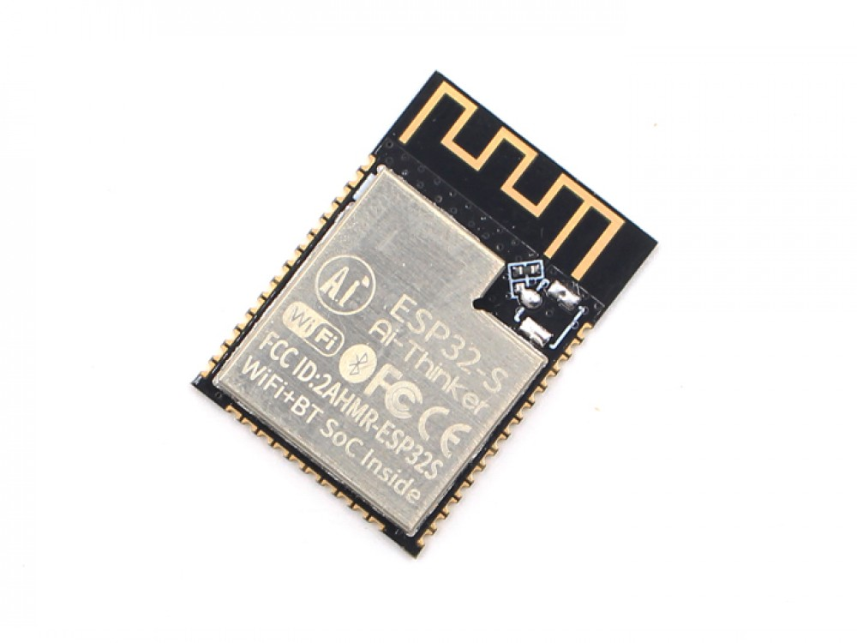
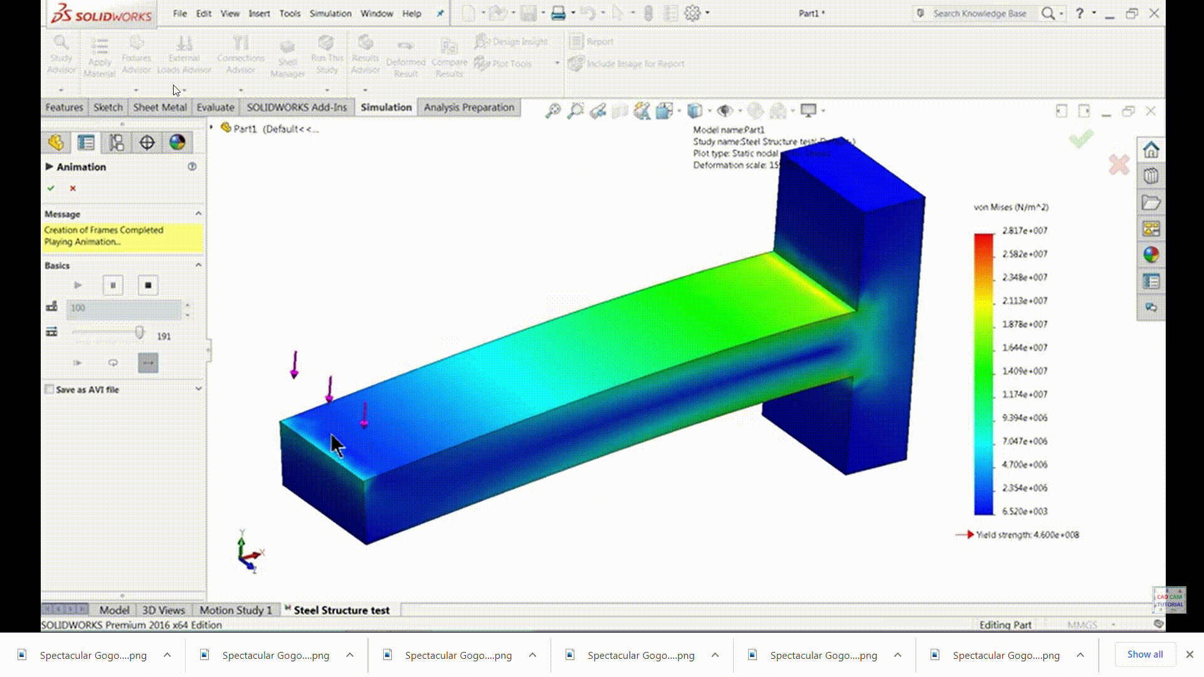

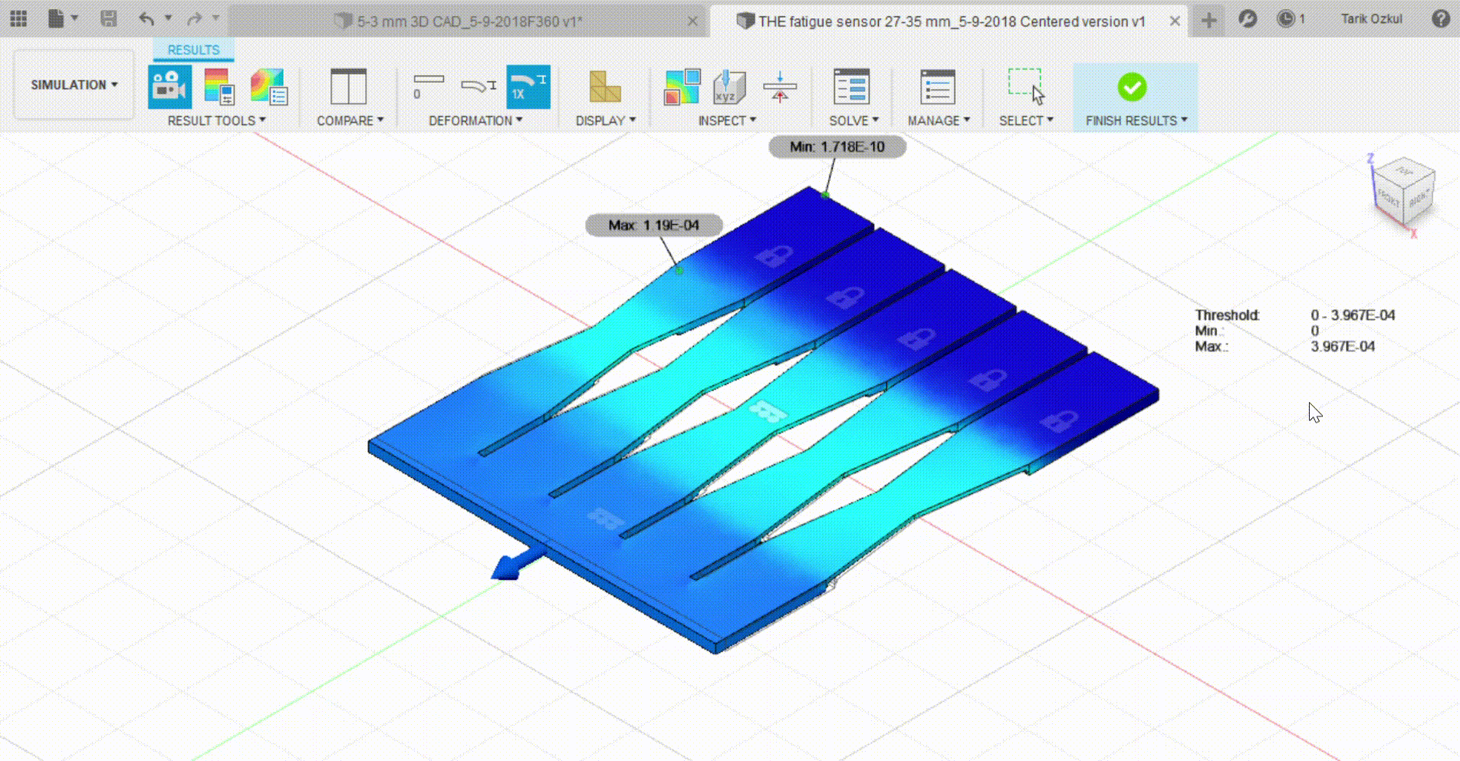
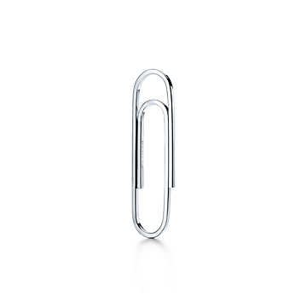
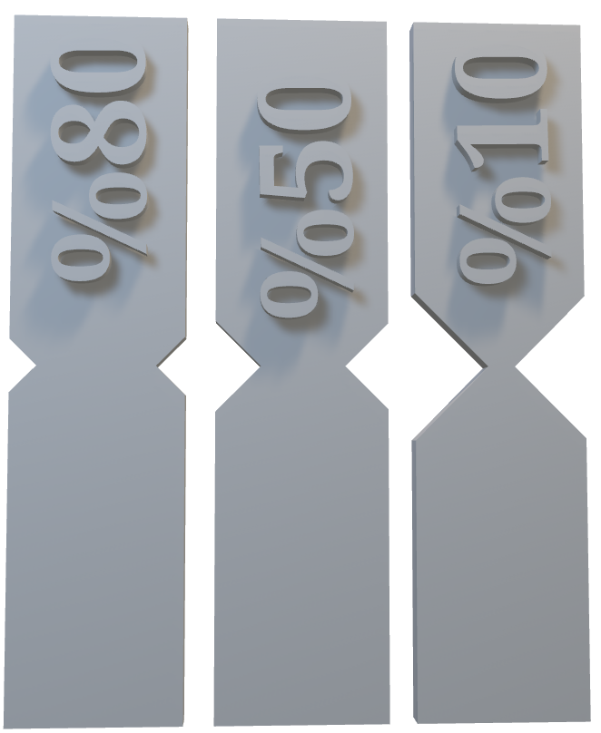
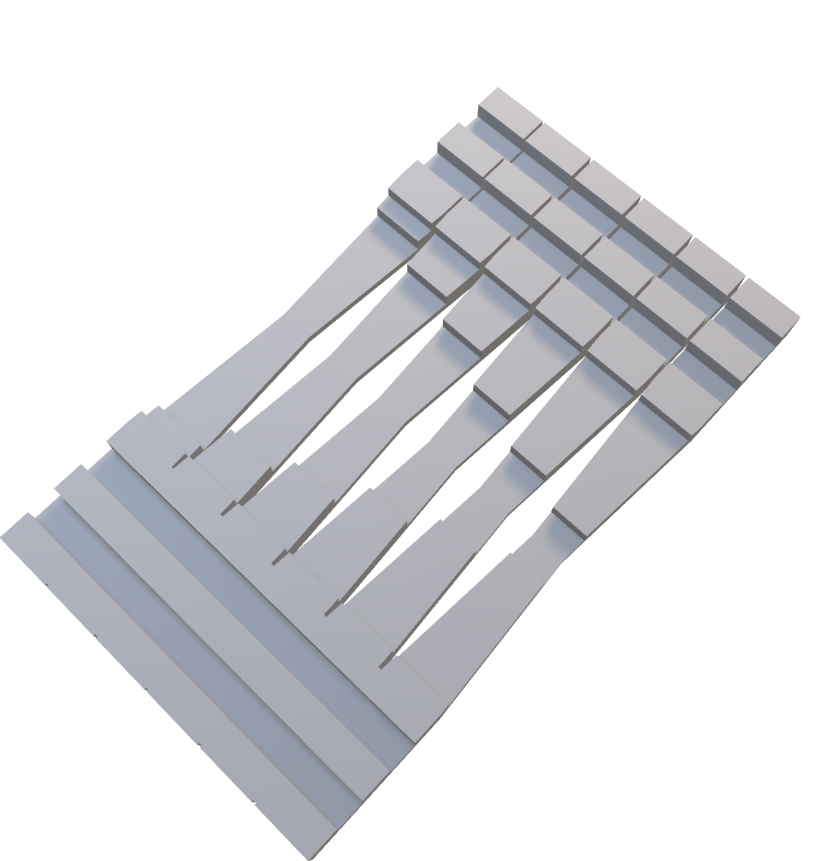

Slide 7
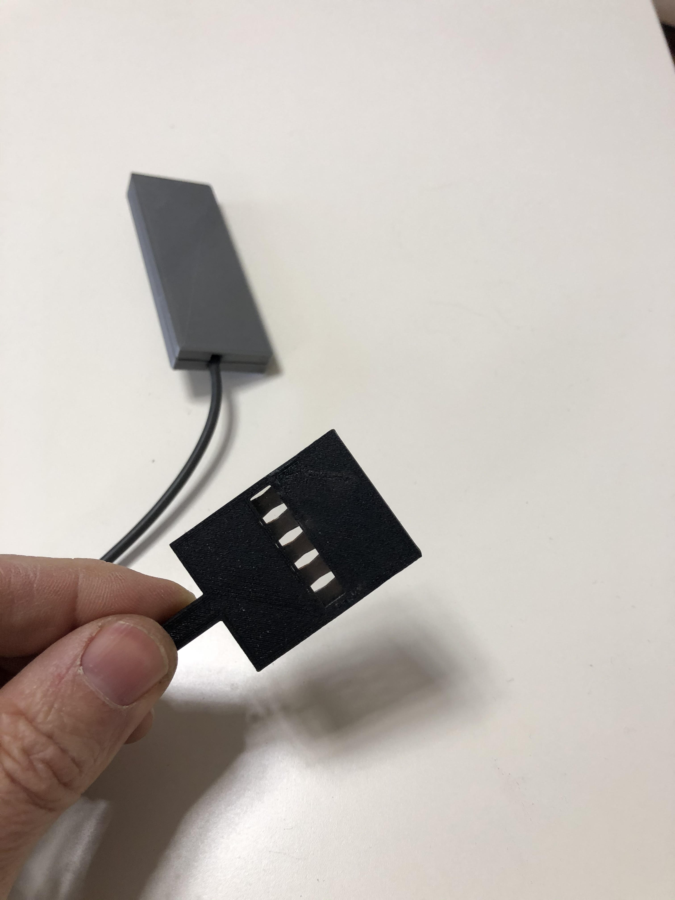
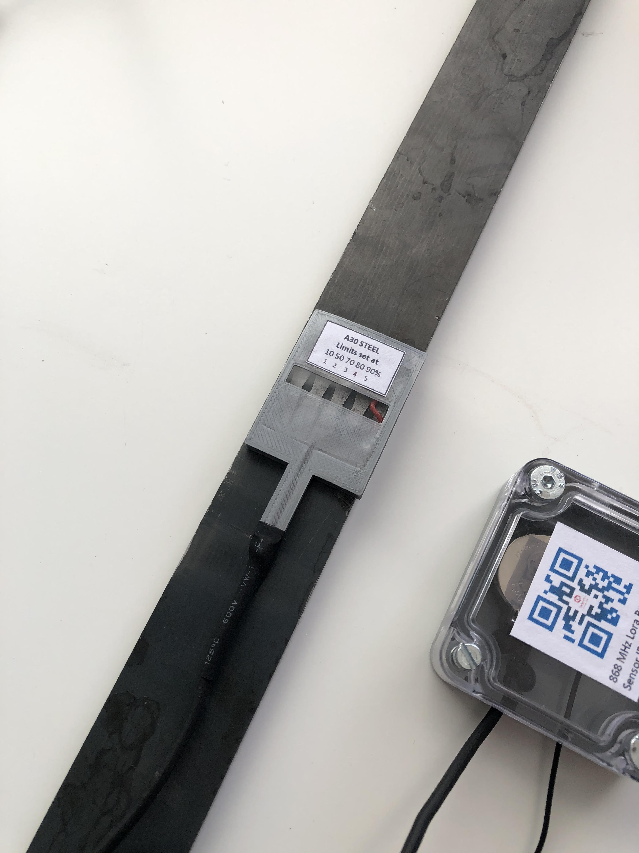
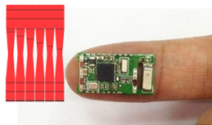

Slide 8

How it works?
FatigProTM monitors fatigue aging of structures using “notched beam” technology. This is our patented technology but technology is well-known, tested extensively and proven in the lab and in the field by independent researchers.

Slide 9
References:
In-Situ Fatigue Sensors for Structural Health Monitoring of Highway Bridges, B. H. M. Priyantha Wijesinghe1, Scott Zacharie2, J. David Baldwin2, Kyran D. Mish1 and Thordur Runolfsson 1School of Civil Engineering and Environmental Science, 2School of Aerospace and Mechanical Engineering, 3School of Electrical and Computer Engineering, The University of Oklahoma, Norman, OK 73019, USA Proceedings of the IMAC-XXVIII February 1–4, 2010, Jacksonville, Florida USA ©2010 Society for Experimental Mechanics Inc.
Fatigue sensor for structural health monitoring: Design, fabrication and experimental testing of a prototype sensor, Subash Gokanakonda, Muralidhar K. Ghantasala*,† and Daniel Kujawski Department of Mechanical and Aerospace Engineering, Western Michigan University, Kalamazoo, MI 49008, U.S.A. STRUCTURAL CONTROL AND HEALTH MONITORING Struct. Control Health Monit. 2016; 23:237–251 Published online 19 June 2015 in Wiley Online Library (wileyonlinelibrary.com). DOI: 10.1002/stc.1765
Fatigue damage and sensor development for aircraft structural health monitoring, S.R. Ignatovich a , A. Menou b , M.V. Karuskevich a , P.O. Maruschak c, aNational Aviation University, Komarova Ave. 1, Kiev 03680, Ukraine b National Airports Authority of Morocco (ONDA), Academie Mohammed V de l’Aviation Civile (AIAC), Morocco c Ternopil National Ivan Pul’uj Technical University, Ruska 56, Ternopil 46001, Ukraine Theoretical and Applied Fracture Mechanics 65 (2013) 23–27
Designing and modeling U-notch fatigue sensor to predict the fatigue life of structural components Tariq Alshahbouni *, Ali Güngör Karabük University, Faculty of Engineering, Metallurgical and Materials Engineering Department, Karabük, Turkey Engineering Science and Technology, an International Journal 22 (2019) 405–415
Corrosion and fatigue health monitoring systems appraisal for offshore steel structures, Mélanie F.C. DENECKER (1), Laurent GAILLET (1), Sylvain CHATAIGNER (1), Jean- François DAVID (1), Richard MICHEL (1), Yannick FALAISE (1) 1 LUNAM University, IFSTTAR, MAST Department, SMC Laboratory, Route de Bouaye, 44344 Bouguenais Cedex, FRANCE. melanie.denecker@ifsttar.fr : https://www.researchgate.net/publication/305498793
Overview of the Monitas JIP Didier L’Hostis/Total, Miroslaw Lech (Mirek) Kaminski/MARIN and Pieter Aalberts/MARIN This paper was prepared for presentation at the 2010 Offshore Technology Conference held in Houston, Texas, USA, 3–6 May 2010.
Sensing and Understanding Fatigue Lifetime of New and Converted FPSOs M.L. Kaminski, MARIN https://www.researchgate.net/publication/239817925

Slide 10
FatigPro VS Crack Sensors..shown in true scale
Crack sensors work here
108,000 cycle
216,000 cycle
324,000 cycle
432,000 cycle
486,000 cycle
FatigPro works in this region
60 min
120 min
180 min
240 min
255 min
Crack appears but almost invisible
270 min
Total failure
Crack becomes visible

Slide 11
What do sensors say?..shown in true scale
Crack Sensor: Your crack is growing!
Crack sensor: Your crack is growing bigger!
Crack Sensor: You got a crack!
108,000 cycle
216,000 cycle
324,000 cycle
432,000 cycle
486,000 cycle
FatigPro: 10% life is gone
60 min
120 min
180 min
240 min
255 min
FatigPro: 50% life is gone
Crack appears but almost invisible
270 min
FatigPro: 80% life is gone
Total failure
FatigPro: 70% life is gone
Crack becomes visible
FatigPro: 90% life is gone

Slide 12
Milestones of FatigPro
May 2018 Startup
November 2018: Selected to Hello Tomorrow 500 Deeptech,
February 2019: Eurotunnel tech. competition winner,
May 2020 TET R&D Winner first place,
November 2020 THY TECHNIC Part 21 procedure
December 2020 NDA with BOEING for adapting to aircraft,
February 2021 TAI collaboration on testing

Slide 13
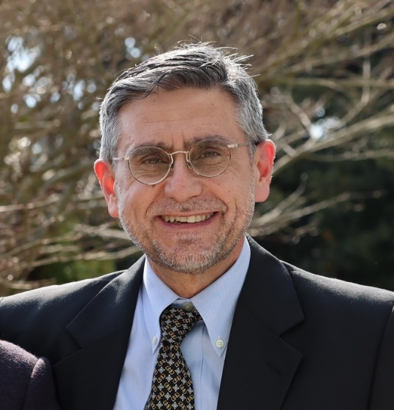

Designer Team
Prof. Dr. Tarik Ozkul
EE PhD Florida Tech
TURKSAT R&D Director Director,
50+ patents,
60+ products
Dr. Halit Kaplan
ME PhD U. of Wisconsin
TUBITAK Advisor,
TURKSAT B. Development,
SESRIC Advisor

Slide 14
info@fatigpro.com

